Slide 1
FACIAL EMOTION RECOGNITION USING FACE-API
DOMAIN: ARTIFICIAL INTELLIGENCE
BATCH-A18
DIVYA SRI.G(2018PECCS128)
HUMSIKA.R(2018PECCS138)
KEERTHANA THILAGAM.D(2018PECCS150)
GUIDED BY : Dr. R. JOSEPHINE LEELA

Slide 2
OVERVIEW
Facial emotion detection is one of the most common applications of Artificial Intelligence. There are many attempts to make an automatic facial expression analysis tools as it has application in many different fields such as robotics, medicine, driving assist systems, and lie detector.
Facial recognition is a way of recognizing or verifying a person’s identity by looking at their face. It identifies people in photos, videos, or real-time using facial recognition systems.
In our project, we will be using face-api.js which is a JavaScript API for face detection and face recognition in the browser implemented on top of the tensorflow.js

Slide 3
ABSTRACT
Emotion detection research has gained significant attention across different scientific disciplines, including Human-Computer Interaction and Ubiquitous Computing.
Facial Emotion Recognition is a technology which is used to analyze our facial expressions from videos or images in order to reveal information on one's emotional state.
It is the task of classifying the expressions on face images into various categories such as anger, fear, surprise, sadness, disgust, happiness and so on.
We will be implementing Javascript API (face-api.js) introduced by Vincent Mühler for detecting facial emotions on the web.

Slide 4
PROBLEM DEFINITION
Human facial expressions can be easily classified into 7 basic emotions: happy, sad, surprise, fear, anger, disgust, and neutral.
Our facial emotions are expressed through activation of specific sets of facial muscles.
These sometimes subtle, yet complex, signals in an expression often contain an abundant amount of information about our state of mind.
Through facial emotion recognition, we are able to measure the effects that content and services have on the audience/users through an easy and low-cost procedure.

Slide 5
LITERATURE SURVEY
TITLE :FACIAL EXPRESSION RECOGNITION USING FACE REGIONS
Year: May 2017
Author :K. Lekdioui, Y. Ruichek, R. Messoussi, Y. Chaabi and R. Touahni
Published in :2017 International Conference on Advanced Technologies for Signal and Image Processing (ATSIP)
Methodology used : LBP, CLBP, LTP, Dynamic LTP and SVM classifier.
Datasets : CK(Cohn Kanade Dataset) , FEED
Observation :
In this paper, we proposed a new facial decomposition for basic emotion states recognition. Based on facial landmarks detected by IntraFace algorithm, seven regions of interest (ROI), corresponding to the main components of face, are first extracted to represent face image.
A preprocessing stage is then applied on these ROIs for resizing and partitioning them into blocks, before performing feature extraction to build face feature descriptor.
Finally, a multiclass SVM classifier is utilized to infer emotion state. A comprehensive experimental study, using different local features, is carried out to compare the proposed method to two state of the art methods; one is based on whole face as a single ROI and the other one uses facial decomposition with six ROIs.
Pros : Reduction in computational complexity of the algorithm.
Cons : The performance decreases while including neutral expression.

Slide 6
TITLE: AN EMOTION RECOGNITION SYSTEM FOR MOBILE APPLICATIONS
Year : February 2017
Author : M. Shamim Hossain; Ghulam Muhammad
Published In : IEEE Access( Volume: 5)
Methodology Used : GMM (Gaussian mixture model) based classifier, Viola-Jones algorithm
Datasets :
Two publicly available datasets are used (Canade-Kohn (CK) and the Japanese female facial expression (JAFFE)).
Observation:
An emotion recognition system for mobile applications has been proposed. The Bandlet transform is applied to some selective frames, which are extracted from the video, to give some sub band images. Local binary patterns (LBP) histogram is calculated from the sub band images. This histogram describes the features of the frames. The Bandlet transform and the LBP are used as features, which are then selected by the KW feature selection method. The GMM based classifier is applied to recognize the emotions.
Pros: Better Performance with higher accuracy; Cons: Feature Selection Process is intricate

Slide 7
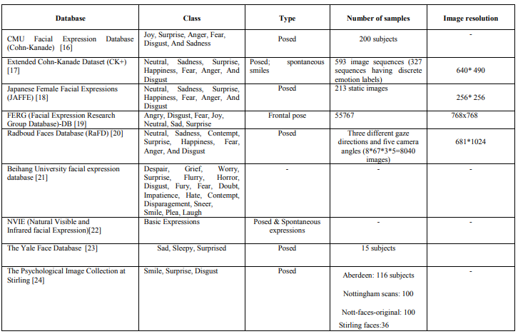
TITLE:A SURVEY: SOFTWARE API AND DATABASE FOR EMOTION RECOGNITION
Year: May 2017
Author :Renuka S. Deshmukh, Prof. Vandana Jagtap
Published in : International conference on intelligent computing and control systems
Observation :
brief introduction towards various tools and description in terms of their features, the approach or methods through which they are implemented ,also describes about the most commonly used facial databases that are considered in emotion recognition systems.
Dataset:

Slide 8
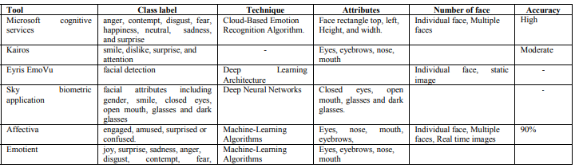
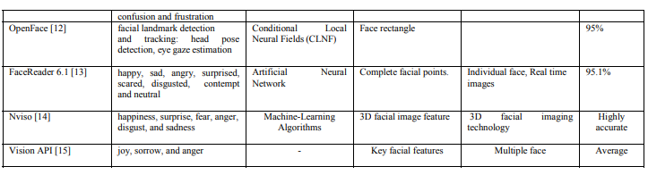
API TOOLS

Slide 9
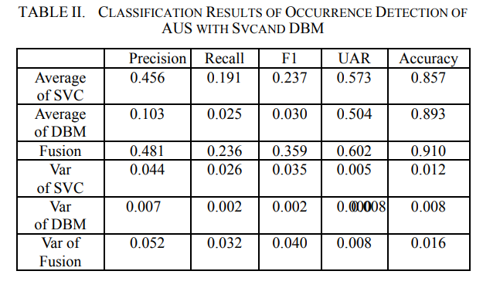
TITLE: FACIAL EMOTION RECOGNITION
Year : August 2017
Author : Ma Xiaoxi; Lin Weisi; Huang Dongyan; Dong Minghui; Haizhou Li
Published In : IEEE
Methodology Used : SVM, Deep Boltzmann Machine (DBM)
Datasets : FERA 2015
Observation:
This paper mainly focuses on the implementation and comparison of different learning methods.
This model compares the experiment results of different prediction systems, the best performance of Occurrence Detection of AUs is obtained by emotional facial classification system with SVM.
Pros: Better performance ; Cons: simple fusion is used

Slide 10
TITLE: FACIAL EMOTION RECOGNITION USING DEEP CONVOLUTIONAL NETWORKS
Year : Dec. 2017
Author : Hossein Khaliliardali, Mostafa Mohammadpour, Seyyed Mohammad. R Hashemi, Mohammad. M AlyanNezhadi
Published In: IEEE 4th International Conference on Knowledge-Based Engineering and Innovation(KBEI)
Methodology Used : Feature extraction for emotion recognition can be divided into two approaches: Geometric feature-based methods and appearance-based methods ; Emotion recognition methods can be divided into two main groups: First group work on static images and second one work on dynamic image sequences ; image preprocessing methods.
Datasets : CK+ dataset ,JAFFE dataset, BU-3DFE
Observation:
This paper presents an emotion recognition system for detecting action units (AUs) which is a coding of facial movements in psychological framework.
A CNN is developed for optimal feature extraction and detecting AUs and by means of detecting seven expressed emotions. The experimental results proven that deep CNNs are able to learn characteristics of facial expression and increase facial emotion recognition accuracy.
The experimental results proven that the Deep CNNs are able to learn characteristics of facial expression and increase facial emotion recognition accuracy.
Pros: Speed improvement and accuracy of face recognition; Cons: Performance is less.

Slide 11
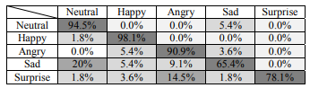
TITLE: EFFICIENT EMOTION RECOGNITION BASED ON HYBRID EMOTION RECOGNITION NEURAL NETWORK
Year: Oct. 2018
Author :Yang-Yen Ou1, Bo-Hao Su,Shih-Pang Tseng, Liu-Yi-Cheng Hsu, Jhing-Fa Wang, Ta-Wen Kuan
Published in : 2018 International Conference on Orange Technologies (ICOT)
Observation :
A webcam is used to capture the image and Then facial image is obtained through high performance face detect neural network. Facial landmarks is used to correct the face.
After that, They input facial image into the multi-person emotion recognition system. In order to improve the accuracy of emotion recognition, a hybrid emotion recognition is proposed based on Convolutional Neural Network.
Microsoft Azure API is used for age and gender recognition
Dataset: The Facial Expression Recognition plus (FER+) database consists of 4500 images of faces from FER
Result:
The recognition rate can achieve 86.14% for facial expression.
CONFUSION MATRIX OF EMOTION ONLINE TEST

Slide 12
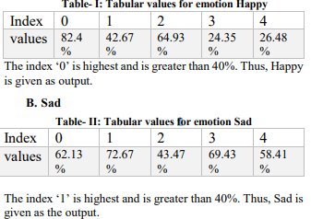
TITLE:FACIAL EXPRESSION DETECTION USING ARTIFICIAL INTELLIGENCE
Year: January 2020
Author :D. Ram Kiran, K. Vinay Kumar, T. Kalyan, K. Ch. Kavya, K. Sarat Kumar
Published in : International Journal of Recent Technology and Engineering (IJRTE) Volume-8 Issue5
Observation :
Face detection is executed utilizing skin color detection and division.
Predefined packages in python like Keras, OpenCV and Face Detection module are discussed in detail and also used.
Dataset: The FER2013 collection consists of the grey scale
images of size 48 x 48
Pros:
simplicity
Cons:
The accuracy can be increased by increasing the samples in the
dataset

Slide 13
TITLE: FACIAL EXPRESSION RECOGNITION IN VIDEOS AN CNN-LSTM BASED MODEL FOR VIDEO CLASSIFICATION
Year : Jan. 2020
Author : Muhammad Abdullah , Mobeen Ahmad , Dongil Han
Published In : 2020 International Conference on Electronics, Information, and Communication (ICEIC)
Methodology Used : CNN-RNN or CRNN system.
Datasets :RAVDESS video dataset [The Ryerson Audio-Visual Database of Emotional Speech and Song]
Observation:
In this paper, they proposed using a well-trained CNN followed by RNN is equally effective for Video Facial Expression Recognition as for other similar tasks e.g. Action Recognition.
Testing a simple, single layer LSTM to learn the temporal features from stacked spatial features extracted by a CNN for each video.
This single layer LSTM network demonstrated very good performance on extracted feature sequences.
To validate our system only for visual facial expression analysis, so we used the data in video-only mode to validate our proposed method(RAVDESS DATASET)
Pros: Outperforms many state-of-the-art appearance-based feature extraction techniques;
Cons: Needs to improve accuracy performance

Slide 14
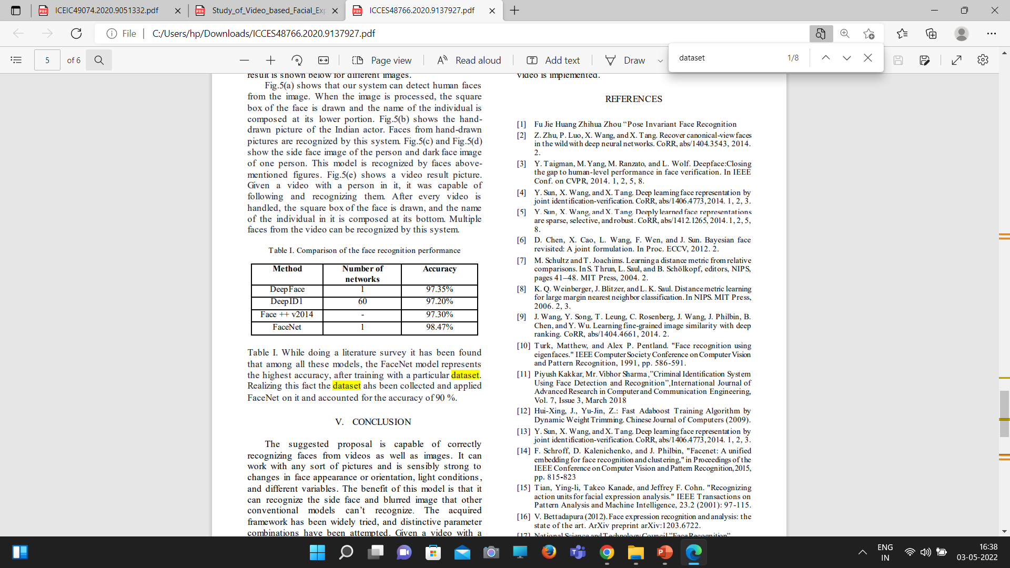
TITLE: FACE RECOGNITION FROM VIDEO USING DEEP LEARNING
Year : June 2020
Author :Saibal Manna , Sushil Ghildiyal , Kishankumar Bhimani
Published In : 2020 5th International Conference on Communication
and Electronics Systems (ICCES)
Methodology Used : Data collection, FaceNet, Triplet loss function
Datasets :YouTube Makeup Dataset (YMD)
Observation:
After recognizing the video with a person in it and after every video is
handled, the square box of the face is drawn, and the name of the individual in it is composed at its bottom. Multiple faces from the video can be recognized by this system.
It has been found that among all these models, the FaceNet model represents the highest accuracy, after training with a particular dataset.
It can work with any sort of pictures and is sensibly strong to changes in face appearance or orientation.
Pros: Easy to implement ;It can recognize the side face and blurred image that other conventional models can’t recognize, can be incorporated in home security systems, visitor analysis systems as well.
Cons: Image features can be severely corrupted due to illumination; feature boundaries can be weakened for faces

Slide 15
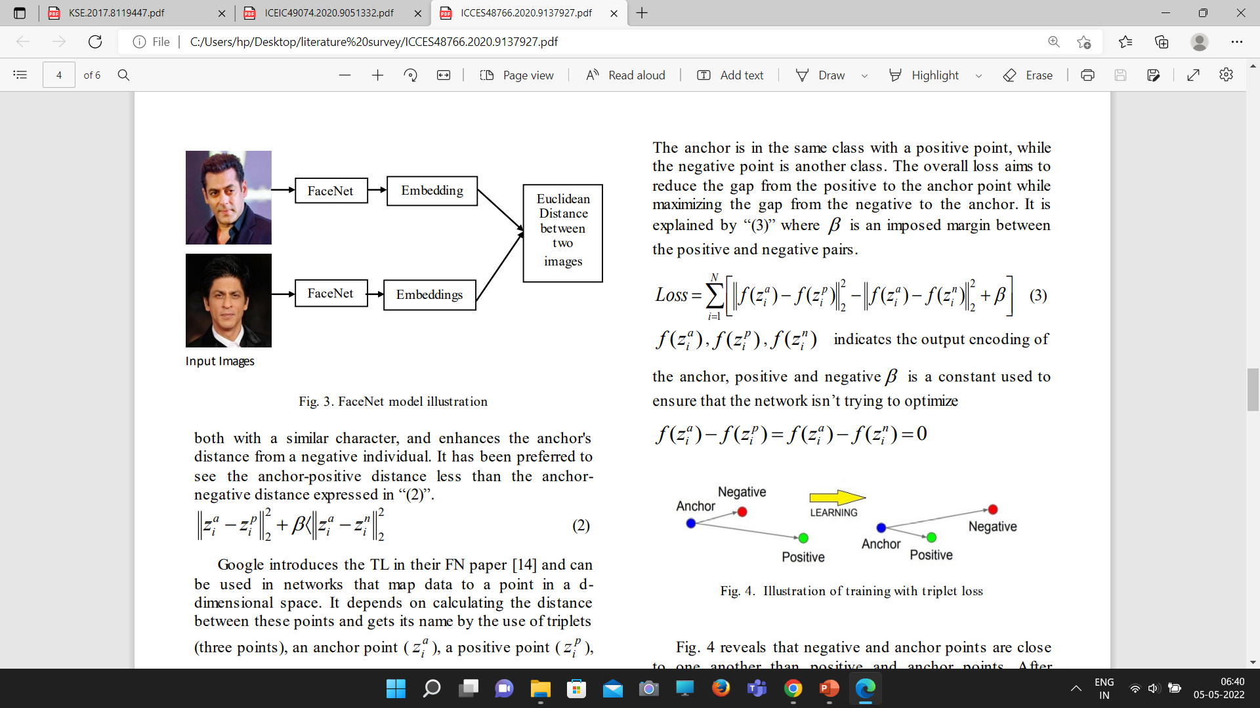
FaceNet
Triplet Loss (TL)

Slide 16
TITLE: MUSIC RECOMMENDATION USING SENTIMENT ANALYSIS FROM FACIAL RECOGNITION
Year : February 2022
Author : Geetika Dhand; Tanisha Beri; Tanvi Sobti; Vidhi Angrish
Published In : SSRN
Methodology Used : Logistic Regression, Neural Network
Datasets :
Song features(energy, liveness, tempo, speechiness, acousticness, instrumentalness, danceability, loudness, valence); Song mood(aggressive, dark, energetic, happy, relaxing).
Observation:
This study aims to develop an effective music recommendation model that employs Face Recognition algorithms in order to assess the user’s mood/emotion.
In order to identify the mood of the song, mean values of the song features are generated with respect to each emotion using Logistic Regression.
The emotion extracted from the user's face is used to extract a random song from the same mood genre in the dataset and is queued after the song playing currently.
Pros: Mood matching is flexible ; Cons: songs are recommended in queue

Slide 17
FEASIBILITY STUDY
TECHNICAL FEASIBILITY
SOFTWARE REQUIREMENTS:
Operating System : Windows 7 / 8 / 10
Language : HTML, CSS
Developing Tool : Visual Studio
Technologies : Javascript
HARDWARE REQUIREMENTS:
Processor : i3 or more
RAM : 4 GB or more
The Visual Studio IDE is a creative launching pad that you can use to edit, debug, and build code, and then publish an app.
Javascript is used by programmers across the world to create dynamic and interactive web content like applications and browsers.

Slide 18
SOCIAL FEASIBILITY
Facial recognition is a biometric form of technology used to identify human faces. By scanning an individual’s face, it will confirm their identity. This could mean that an individual can’t have multiple driver’s licenses, state IDs or could be identified within a law enforcement database.
Facial recognition is one of the key components for future intelligent vehicle applications, like determining whether a person is allowed or authorized to operate a vehicle.
In face analysis, face detection helps identify which parts of an image or video should be focused on to determine age, gender and emotions using facial expressions.
Some of the Face Recognition APIs are,
Microsoft Computer Vision API
Lambda Labs API
Kairos
Face++

Slide 19
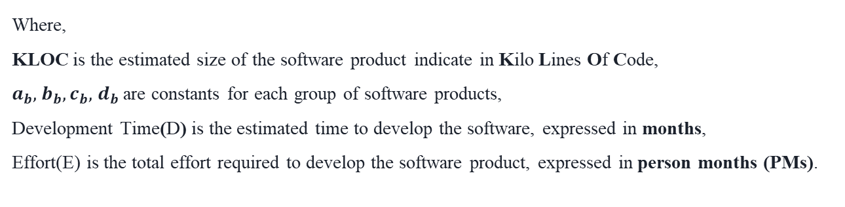
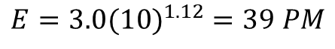
ECONOMIC FEASIBILITY
Let us assume, KLOC = 10K;
Estimation of development Effort (E) :$E=a_{b}{\left(KLOC\right)}^{b}b$
$$E=3.0{(10)}^{1.12} =39 PM$$
Estimation of development Time (D) : $D=c_{b}{\left(E\right)}^{d}b$
$$D=2.5{(39)}^{0.35} =9 months$$

Slide 20
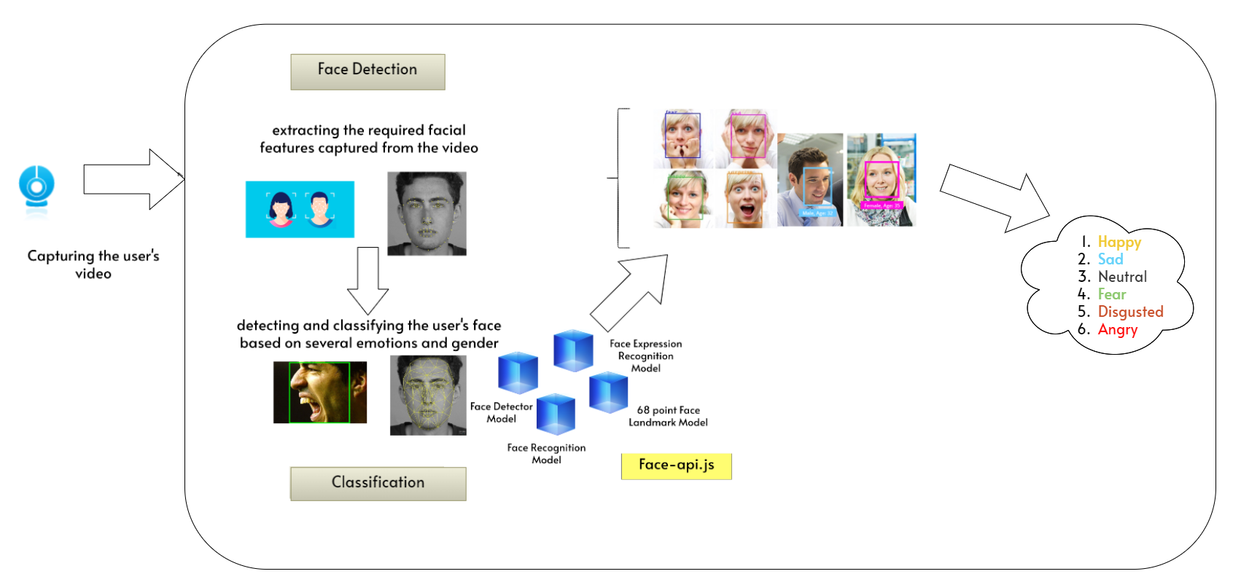
SYSTEM ARCHITECTURE

Slide 21
THANK YOU !

